Slide 1
Answers
How many languages can you name?
Bonjour | French
Xin chao | Chinese
Hola | Spanish
Ciao | Italian
Shalom | Jewish
Guten Tag | German
Hallå | Swedish
11001110 | Binary
Notes:
french

Slide 2
CODE
Computers only understand their language – just like we only understand our language.
We are going to use small basic so we need to ensure we are speaking small basic language.

Slide 3
Microsoft® Small Basic
Introduction to Small Basic

Slide 4
Introduction to Small Basic – Learning Intentions
In this lesson, you will:
Be able to: Describe Small Basic.
Know how to: Explore the Small Basic environment.
Be able: Write a Small Basic program.
Understand how to: Use IntelliSense® technology.
Be able to: Save your program.

Slide 5
Introduction to Small Basic - Connect
Keyword Words & Definitions:
Save
SaveAs
Keyboard Shortcut
F5, Ctrl & S
Input
Output
Button
Toolbar
Editor
Help Window
Intellisense
Statement
Object
Software
Hardware
Program
Give an example of a software program?
Microsoft Word, PowerPoint, Excel
Name a software company.
Microsoft, Google, Apple
Give an example of an operating system.
Windows, Android and iOS or OSX
Give an example of a programming language.
Scratch, Python, AppInventor, Small Basic
What is hardware
Hardware is something physical you can touch; a mouse, a keyboard and iPad

Slide 6
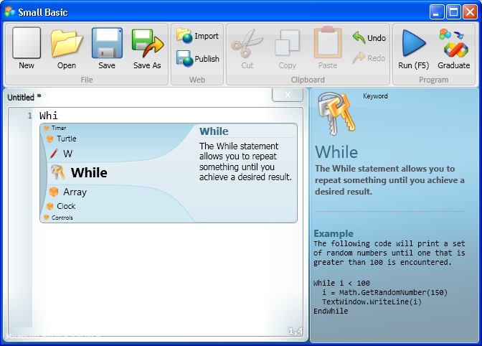
What is Small Basic?
A program is a set of instructions that a computer can understand. To write that set of instructions, you use a programming language.
Small Basic is a programming language…
…that makes computer programming extremely approachable, easy, and fun!

Slide 7
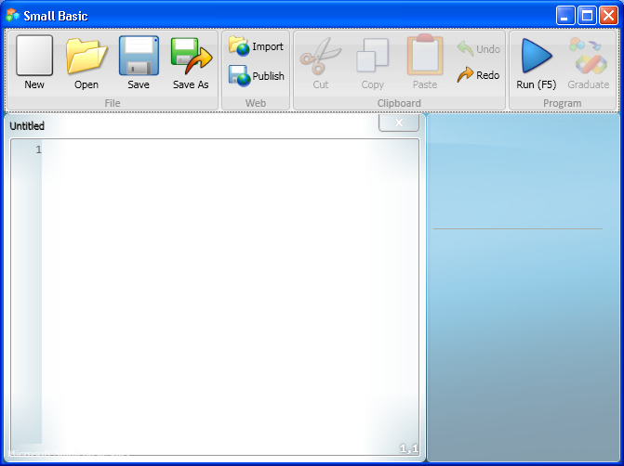
The Small Basic Environment
Small Basic provides you with an extremely simple yet powerful development environment with features like instant context-sensitive help.
1. You write your Small Basic programs in the Editor.
2
3
2. You can run various commands by clicking buttons on the Toolbar.
1
3. As you write code, you can find information about commands in the Help window.
Notes:
Let’s explore the different elements of the environment where you write and run your Small Basic programs.
You can open and work with multiple Editor windows at one time.
The Editor window that contains the program you are currently working with is the active Editor.
You can indent your program code more consistently by highlighting it, right-clicking it, and then clicking Format Program.

Slide 8
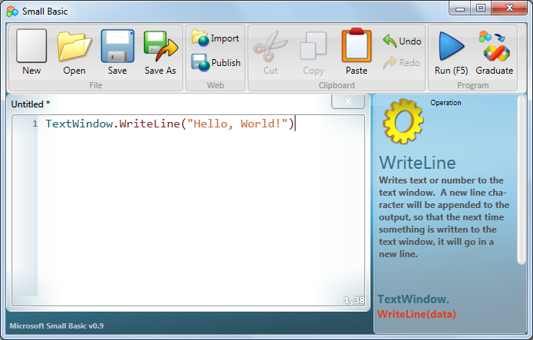
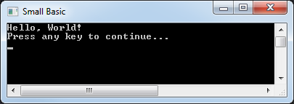
Your First Program
Now that you’re familiar with the environment, you are ready to start programming!
As you know, the Editor is where you write your programs. So, let’s write the following line in the Editor: TextWindow.WriteLine(“Hello, World!")
You have created your first program, and now you can run it and check the result!
output
Click the button on the Toolbar.
Notes:
You can run your program either by clicking Run on the Toolbar or by pressing F5 on the keyboard.
In the next lesson, you will analyze a program in detail to learn more about it.
Code:
TextWindow.WriteLine("Hello, World!")

Slide 9
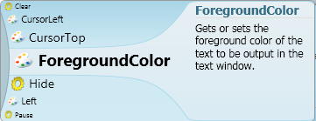
IntelliSense − Making It Easy
While you were typing, did you notice that a list of items appeared with their explanations?
These items are part of an “IntelliSense” list, which you can use to type your programs faster.
An IntelliSense list contains commands that you can type. You can scroll through the list by pressing the UP and DOWN arrows on your keyboard, and you can press ENTER to insert the highlighted command into your code.

Slide 10
Saving Your Program
After you write a program, you must save it if you want to change or run it later.
To save your program, you can click Save on the Toolbar, or you can hold down the CTRL key on the keyboard while you press the “S” key.
Notes:
You should save your program frequently so that you do not lose your work if the power fails or your computer suddenly shuts down.
Code:
TextWindow.WriteLine("Greetings to All")

Slide 11
Let’s Summarize…
Congratulations!
Now you know how to:
Define Small Basic.
Explore the Small Basic environment.
Write a Small Basic program.
Use IntelliSense.
Save your program.

Slide 12
Show What You Know
Now that you know some facts about Small Basic, you can demonstrate what you’ve learned by answering the following questions:
What is Small Basic?
Which feature of Small Basic helps you type your program faster?
How do you run your Small Basic program?
Why do you think your programs don’t always work? Give an example
Notes:
Answers:
A programming language.
IntelliSense.
By clicking Run on the Toolbar or by pressing F5 on the keyboard.
Because mistakes have been made when typing in the code for example mispelt words or missing out brackets or speach marks

